Slide 1

SMART INDIA HACKATHON 2026
TITLE PAGE
Problem Statement ID – 26132
Problem Statement Title - Strengthening market linkages and price discovery for farmers
Theme - Agriculture, FoodTech & Rural Development
PS Category- Software/Hardware: Software
Team ID-
Team Name:Conquerors

Slide 2

IDEA TITLE
📷 AI QUALITY GRADING
Smartphone image → Vision model →Size + Ripeness + Defects → Grade
📊 NET PRICE DISCOVERY
Mandi Price − Freight − Diesel − Handling = REAL NET PRICE
📈 14-DAY SALE ADVISOR
Historical/current prices → trend analysis →Sell Now / Wait / Store
🤝 FPO + ESCROW
Small farmer lots → pooled demand → shared transport → buyer funds locked before dispatch
📈
WHEN SHOULD I SELL?
│
▼
┌──────────────┐
│ 14-DAY AI │
│ SALE ADVISOR │
└──────────────┘
📷 ─────────► 👨‍🌾 ◄───────── 📊
AI GRADING NET PRICE
│
▼
🤝 FPO + ESCROW
Not just “What is today's price?” — but “What should I do with my crop?”

Slide 3
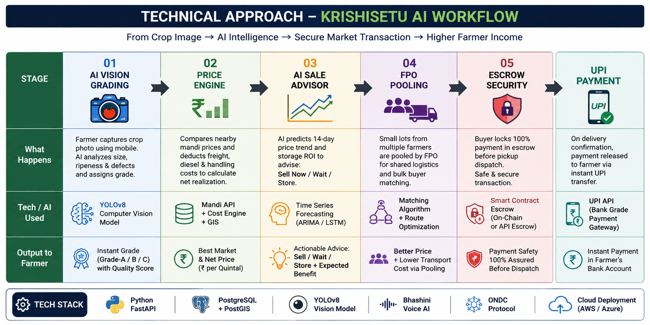
TECHNICAL APPROACH

Slide 4
FEASIBILITY AND VIABILITY
🛡️Built for Real-World Village Constraints
Use four large problem cards.
📡 NETWORK
Challenge
Poor 2G/3G connectivity can interrupt cloud-dependent applications.
KrishiSetu
Offline-first PWA
NO INTERNET
↓
LOCAL STORAGE
↓
USER CONTINUES
↓
AUTO SYNC
🗣️ DIGITAL LITERACY
Challenge
Typing and complex interfaces can discourage adoption.
KrishiSetu
Voice-first interaction
FARMER SPEAKS
↓
BHASHINI
↓
REGIONAL LANGUAGE
↓
ACTION
🚚 LOGISTICS
Challenge
Small individual farm lots make transportation expensive.
KrishiSetu
FPO Milk-Run Pooling
F1 ─┐
F2 ─┤
F3 ─┼──► 🚚
F4 ─┤ ↓
F5 ─┘ MARKET
💸 PAYMENT
Challenge
Buyer payment uncertainty creates risk.
KrishiSetu
Escrow-backed transaction
BUYER
↓
₹₹₹
🔐 ESCROW
↓
PICKUP
↓
💰 FARMER
Offline-ready • Voice-first • Logistics-aware • Payment-secured

Slide 5
IMPACT AND BENEFITS
From Price Discovery → Income Discovery
Don't just show four statistics.
Show the economic transformation.
Impact dashboard
Metric | Target
Farmer Net Realization | +22.5%
Post-Harvest Distress Loss | −30%
Shared Logistics Cost | −32%
Buyer Payment Protection | 100% Escrow
WITHOUT KRISHISETU
HARVEST
↓
LOCAL PRICE
↓
MIDDLEMAN
↓
EXPENSIVE TRANSPORT
↓
DISTRESS SALE
↓
❌ LOWER NET REALIZATION
WITH KRISHISETU
HARVEST
↓
📷 QUALITY GRADE
↓
📊 MARKET COMPARISON
↓
📈 SELL / WAIT DECISION
↓
🤝 FPO POOLING
↓
🔐 ESCROW
↓
💰 HIGHER NET
REALIZATION
Target beneficiaries
👨‍🌾 Farmers — better selling decisions 🤝 FPOs — collective bargaining & logistics 🏢 Bulk Buyers — standardized, traceable sourcing
Important: I would label these as projected targets, not achieved results, unless your team has actual field-test evidence.

Slide 6
RESEARCH AND REFERENCES
Powered by India's Agriculture + Digital
Infrastructure
KRISHISETU AI
│
┌───────────┼───────────┐
▼ ▼ ▼
MARKET LANGUAGE COMMERCE
DATA AI DPI
│ │ │
▼ ▼ ▼
AGMARKNET BHASHINI ONDC
e-NAM
│ │ │
└───────────┼───────────┘
▼
AI DECISION
│
▼
👨‍🌾 FARMER
Research foundation
Government / Data
Agmarknet
e-NAM
NITI Aayog
Ministry of Agriculture / DFI
Digital Public Infrastructure
ONDC
Bhashini
Technical research
Computer Vision for agricultural produce grading
AI-based agricultural price/market intelligence
Data → AI → Decision → Market → Payment

